Slide 1
Day 2: Supervised Learning & Classification
Mahmoud Abdelmoneum & Nicolas Stone
21 January 2025

Slide 2
Agenda
Regression exercise wrap up (60 minutes)
Supervised learning (30 minutes)
Classification (30 minutes)
Problem solving process in ML (15 minutes)
Classification exercise (120 minutes)

Slide 3
Section I: Finish Regression Exercise

Slide 4
Section II: Supervised Learning

Slide 5

Review Question: What is Supervised Learning

Slide 6
Review Answer: Supervised learning is a kind of ML or a class of ML models that extract patterns from labeled question-answer pairs; That is, the model learns to predict an output based on existing labels of what the output should be

Slide 7
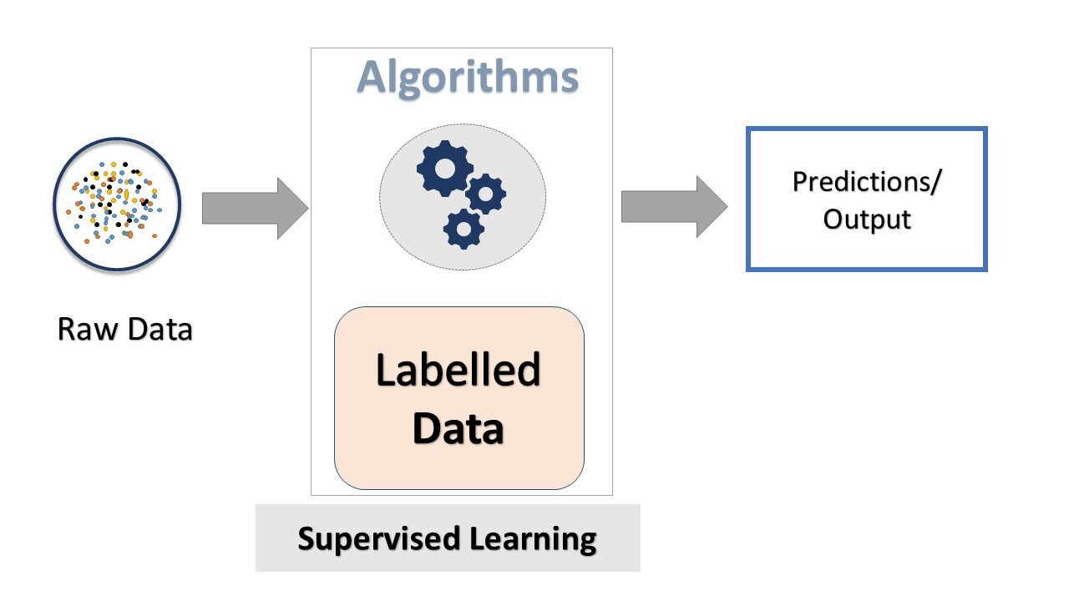
Training Supervised Models
Key difference is in how these models are trained
Since supervised models have labeled input-output pairs, when we train using gradient descent, at each step we check our model’s prediction vs. the true prediction (label)
The data used to do this is called training data, which we iterate over, consistently updating the model’s parameters at each step

Slide 8
Challenge Question: What might be an issue that arises when we train these models? (Hint: Models should be good at predicting values for values our models have not seen before)

Slide 9
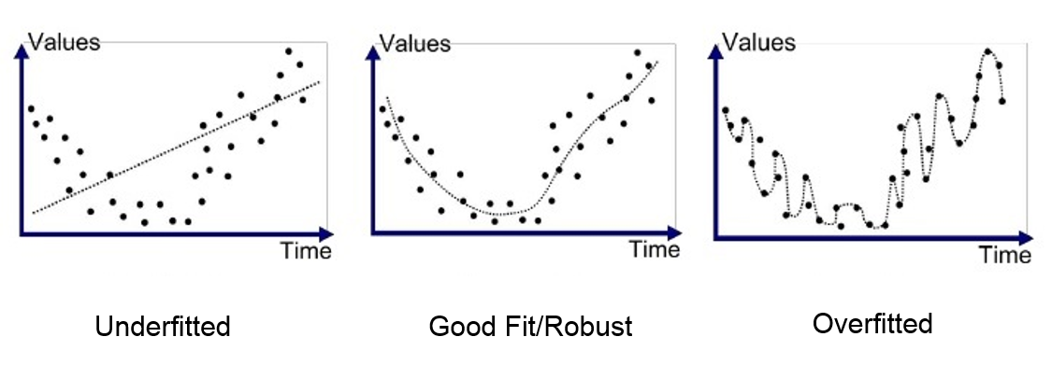
Challenge Answer: Overfitting
Data is inherently a little bit noisy
We want our model to learn parameters that fit most data that it sees
If it overfits to the training data, it will not generalize well to unseen examples

Slide 10
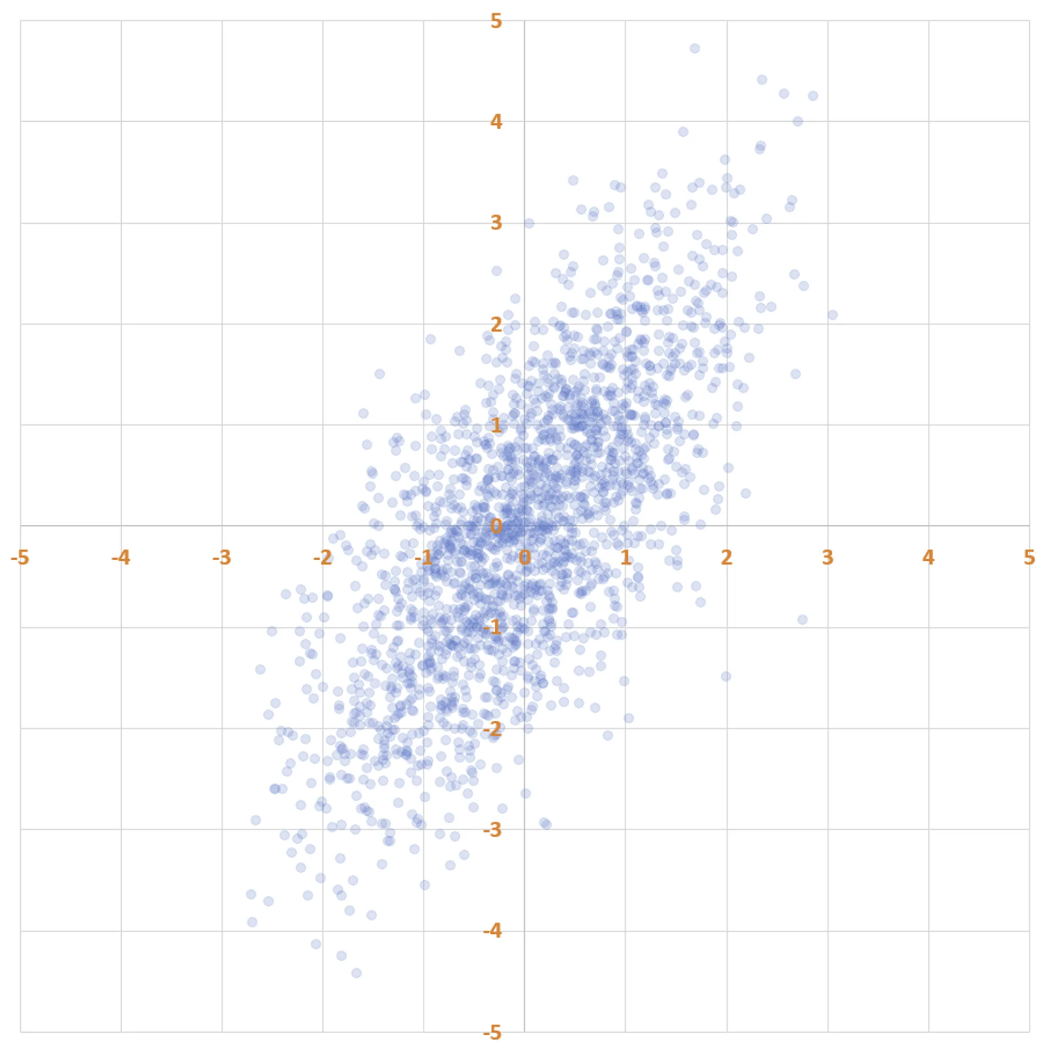
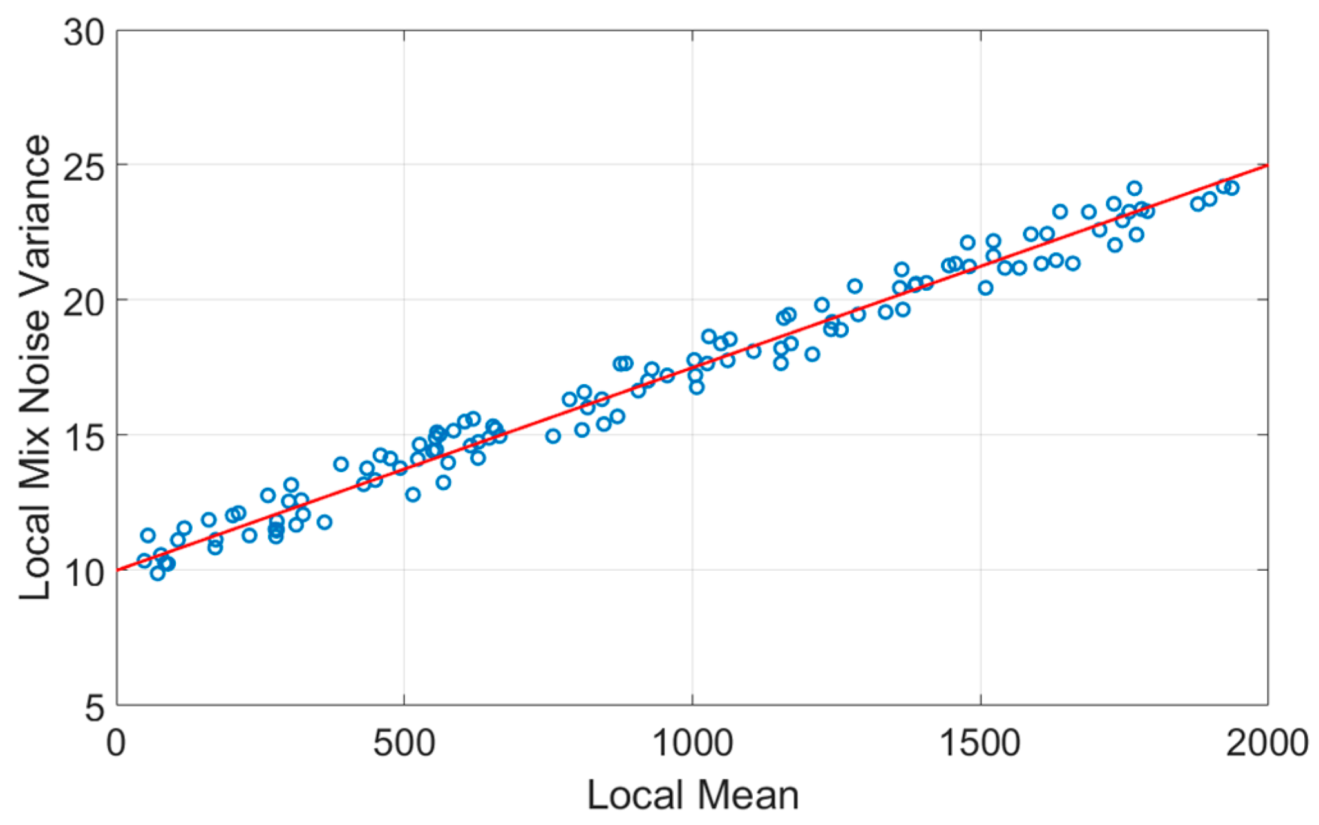
Data: Data Quality
Noise vs. signal?
Stratification?

Slide 11
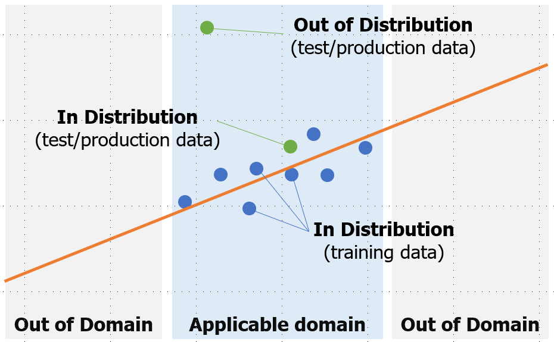
Data: In Distribution vs. Out of Distribution

Slide 12
Section III: Classification Deep Dive

Slide 13
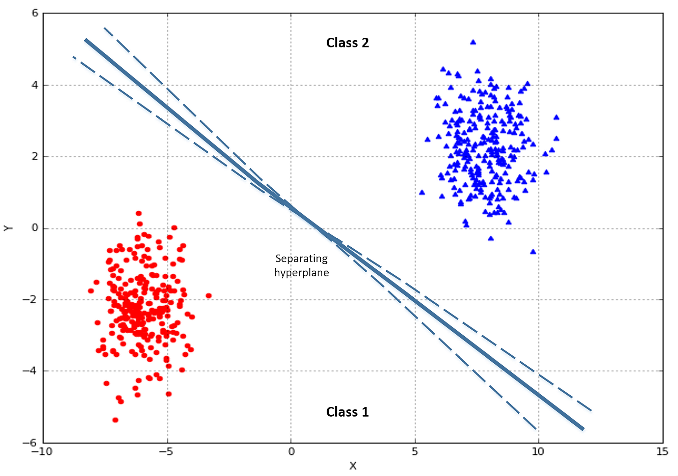
Classification Detailed Definition
The class of ML problems concerned with predicting a categorical label given an input
Examples:
Given an image, label it as a dog or a cat
Given an email, label it as spam or not spam
Given a text, label it as nice, mean, or neutral
Given a review for a product, label it as positive or negative

Slide 14
Exercise: Take 10 minutes to discuss 5 classification problem examples with your group

Slide 15
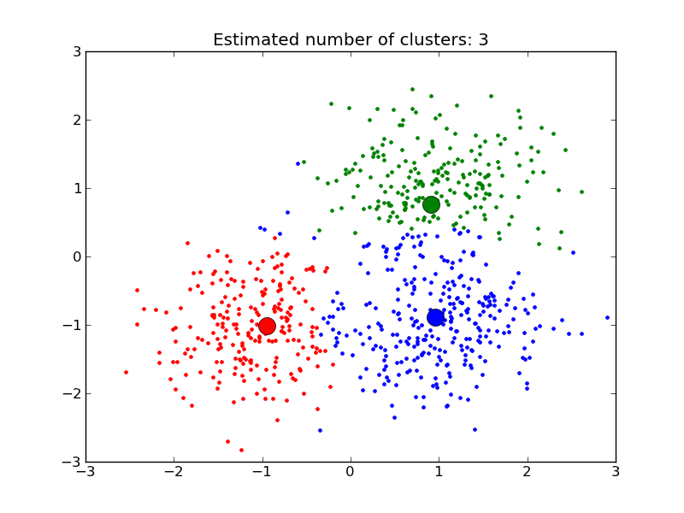
How would you go about classifying this data?

Slide 16
Answer: 3 distinct groups, draw 2 dividers

Slide 17
Types of Classification Models

Slide 18
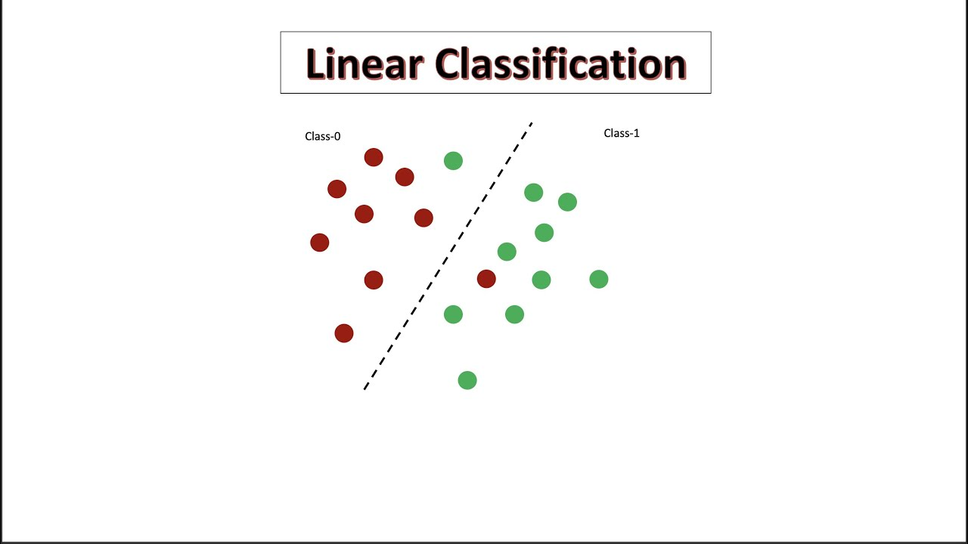
Simplest: Linear Classification (Supervised)

Slide 19
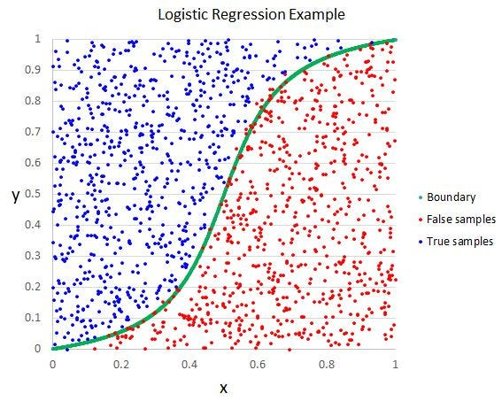
Logistic Classification (Supervised)

Slide 20
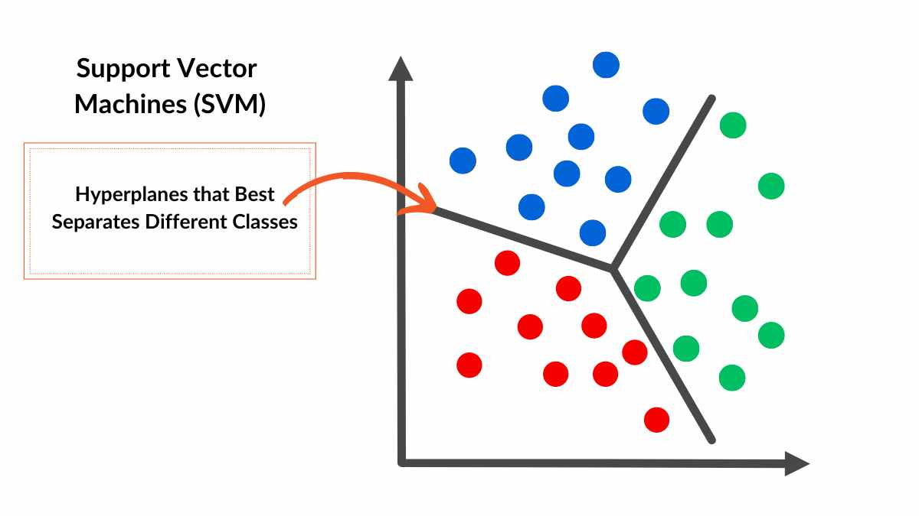
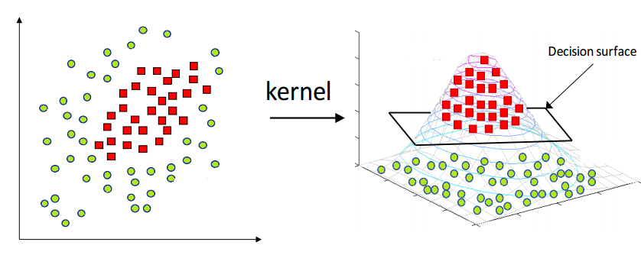
Support Vector Classifiers
Similar to linear classifier
Can be used with multiple categories
Uses hyperplanes to split up the data into distinct categories
If data points are in >2D space, think of splitting with hyper plane as using flat sheets of paper to split up the points!

Slide 21
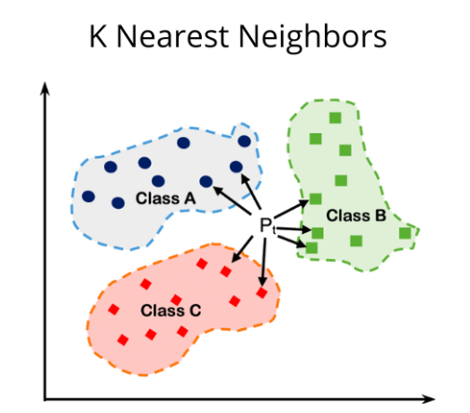
K-Nearest Neighbors (known as KNN → Unsupervised)

Slide 22
Group Exercise: There are many, many other kinds of classifiers. Take 10 minutes with your group to find 3 new classifiers alongside the shapes or techniques that they user.

Slide 23
Section IV: Problem Solving in ML

Slide 24
Back to the basics: Why do we use ML?

Slide 25
One Answer: To predict some unknown output given some input

Slide 26
Back to the basics: What is the key principle that underlies this idea?

Slide 27
Simple: Pattern Recognition!

Slide 28
Back to the basics: So what kind of problems do you think we can solve using ML?

Slide 29
Answer: Any problem that might have some kind of underlying pattern (not completely random!)

Slide 30
Problem Solving w/ ML Framework (ordered steps)
Come up with a problem, and confirm that it is actually a problem
Determine if it is a good problem for ML: Is there a reasonable chance that there is some kind of pattern that underlies it?
Decide whether it is a classification or regression (or maybe some kind of other) problem
Determine what kind of data could reveal the pattern underlying the problem
Using this data, come up with an input-output for your model
Come up with a training process (e.g data and model) to build your ML model mapping your input-output pair
Test your model on new data!

Slide 31
Section V: Classification Exercise

Slide 32
Classification Exercise Overview
3 Topic Options:
Healthcare dataset
Sustainabilit dataset
Ecology dataset
We provide the dataset (code to download the dataset)
You will build a classification machine learning model for your dataset of choice
Allowed to use any tools you need to do this (ChatGPT, Google, etc.)
Will present your work/knowledge in the form of both a Google Doc & a slideshow

Slide 33
Classification Exercise Instructions
With your group, decide on which dataset you want to work with
Split up into 2 groups–coders (group members that know Python), and non-coders (students that do not know Python)
Coders: Code up the classification model!
Create a copy of the Google Colab with your dataset of interest
Download the dataset, familiarize yourself with its structure
Build your classification model using sci-kit learn
Make 2 graphs:
1 of the model’s decision boundaries on the training data
1 of the model’s decision boundaries on the testing data
Include classification accuracies for both!
Non-Coders: Present the ML model building work!
First, create a Google Doc, in it, write a paragraph about each of the following:
What is the problem that you are solving?
What is the data that you are working with (structure, where it is from, etc.)
What kind of model are you building? How are you training it?
How are you assessing how good your model is?

Slide 34
Classification Exercise Instructions Continued
4. Non-coders:
Then, present your work in the form of a slideshow presentation
Slideshow should address each of the same points as listed previously for your Google Doc
But here, minimize writing on your slides, and try to use more visuals/brief bullet points

Slide 35
Classification Exercise Instructions Continued
Deliverables by end of day:
Colab with a working classification model for your dataset + two plots, one of decision boundaries with training data, and one of decision boundaries with test data
Google Doc explaining what you did conceptually (problem, solution, model, data, results)
Slideshow presentation of knowledge from Google Doc (same content)

Slide 36
Please Find Gdrive For Exercises At The following link
https://tinyurl.com/2pryuuea
Classification Exercises → Templates
Select the template for the project that you want to do!
Sustainability: STUDENT_Classification_Sustainability.ipynb
Ecology: STUDENT_Classification_Ecology.ipynb
Healthcare: STUDENT_Classification_Healthcare.ipynb
Make a copy of the Colab that you want to work with, and get to coding
When done, upload work!
Code: Classification Exercises → Code_Upload
Slides: Classification Exercises → Slides_Upload

